Slide 1
Automation Design Concepts
Adv. Advisory | ACCTG 528 | Class 06
MPAcc Class of 2026

Slide 2

What will we do today?
Review
(Initial) Review of Submissions
Admin: Teams
RPA Models
The Automation Spectrum
Process Assessment
Introducing Agentic Workflows
Optional introduction to set-up requirements for an open source approach (time- & interest-permitting).

Slide 3
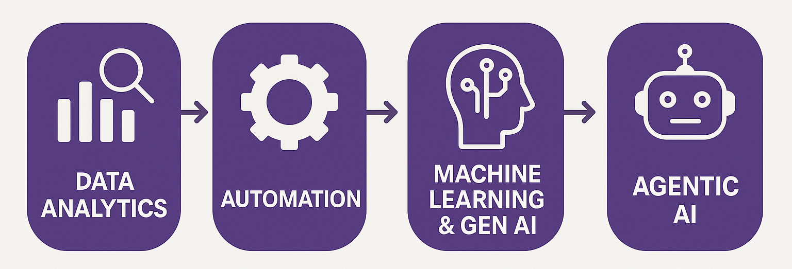
Course Diagram (high-level)

Slide 4











UiPath Agentic Automation
Notes:
Everything happens in one place: the UiPath Platform—where AI Agents aren’t just assistants, they’re true work partners, transforming complexity into a seamless, orchestrated operation.
We break it down into three powerful layers: Activities (the building blocks—reading, processing, integrating), Workflows (connecting the dots with human-in-the-loop and testing), and Processes (the big picture—managing, optimizing, and enhancing enterprise operations).
Agentic Orchestration / Maestro takes automation even further—coordinating UiPath Agents, third-party AI models, people, robots, and tools into a single, intelligent system.
Your existing systems don’t need to be reinvented—our platform integrates seamlessly with your data, applications, and workflows while maintaining enterprise-grade security, governance, and AI trust.
We’re not just compatible with your tech stack—we enhance it. From cloud providers like AWS, Google, and Azure to enterprise apps like Salesforce and SAP, we turn digital chaos into a symphony of efficiency.

Slide 5
UiPath versus open source (e.g., python)
UiPath is a closed source software, typically used at the enterprise level
It offers community licenses to individuals/small businesses (currently they renew indefinitely)
Large overhead w/ orchestration can be overkill for some desktop apps.
Has good built in LLM connectors.

Slide 6
UiPath versus open source (e.g., python)
Open source alternatives will largely have to be constructed from scratch (orchestration layer in particular).
For example, python can be used to replicate many of the desktop-level processes, but making the workflow in a logical order is not longer drag & drop.
Open source with locally installed LLMs (not using an API), has the data not leave the local environment:
Positives: privacy and control
Negatives:
Python upskilling costs
Hardware dependent (←likely our biggest hurdle)

Slide 7
What will we do today?
Review
(Initial) Review of Submissions
Admin: Teams
RPA Models
Automation Model Spectrum
RPA to Agentic workflows discussion
Optional introduction to set-up requirements for an open source approach (time- & interest-permitting).

Slide 8
Submissions – high-level
Very wide dispersion of RPA workflows:
Extremes: From not started to nearly complete.
Majority:
Most intermediate cases appear stuck in moving data between RPA steps, or
Translating the workflow diagram into logical RPA steps
Edge cases: Might require more powerful tools (document understanding, more developed data manipulation frameworks).

Slide 9
Admin: Team formation
Goal: 10 teams of 4 individuals/team
Balanced, but requires some shuffling of Fall Qtr Teams
Potential solution:
Refresh teams based on:
Existing working relationships
Topic alignment

Slide 10
What will we do today?
Review
(Initial) Review of Submissions
Admin: Teams
RPA Models
Automation Model Spectrum
RPA to Agentic workflows discussion
Optional introduction to set-up requirements for an open source approach (time- & interest-permitting).

Slide 11


Automation models
There are six automation models tailored to meet a broad spectrum of automation needs.
Model 1: Fully
Unattended
Model 4: Attended,
interval
Model 2: Partially Unattended
Model 5: Attended in tandem
Model 3: Human in
the loop
Model 6: Hybrid automation

Slide 12
1. Fully unattended: What it does
In this automation model, the unattended robot:
Launches automatically based on triggers
or schedules.
Is centrally managed by a workflow orchestrator
for 24x7 operation.
Executes the process consistently and alerts
exceptions if any.

Slide 13
1. Fully unattended: A real-life scenario
Collate all
relevant sales
data from
multiple systems
Aggregate
data
Check data
integrity and
quality. Pass
back exceptions
where required
Verify
data
Create and
send report

Slide 14
2. Partially unattended: What it does
In this automation model, the partially unattended robot can:
Take over scheduled tasks or upon your instruction.
Handle preparatory work and process initiation.
Program complex business rules.
Provide data validation and assurance.
Notify you only in case of exceptions.

Slide 15
2. Partially unattended: A real-life scenario
Collate all
relevant
appraisal
information
Trigger
automation
via keystroke
Review
appraisal
Order
appraisal
Gather
appraisal
information
Pass to
advisor

Slide 16
3. Human in the loop: What it does
In this model, the unattended robot can:
Initiate processes based on schedules or triggers.
Request your input when needed.
Resume the process after you've completed your task.
Repeat this cycle as required within the process.

Slide 17
3. Human in the loop: A real-life scenario
Scan the
paper-based
invoice
Trigger
automation
via keystroke
Check and
verify data
Trigger
automation
Check data
in the
invoice fields
Pass to ERP
system
Pass poor
quality data
to user

Slide 18
4. Attended, interval: What it does
In this model, the attended robot can:
Launch on-demand using mouse clicks or hotkeys.
Run the process directly from the UiPath Assistant.
Complete the task in exactly the same way as you would.
Complete the task and return the process to you.

Slide 19
4. Attended, interval: A real-life scenario
Trigger
automation
via hot key
Verify data
Trigger
automation
with hot key
Collate all
relevant data
from multiple
sheets
Aggregate
and
manipulate data
Create and
send report
Pass data
back for
verification

Slide 20
5. Attended in tandem: What it does
In this model, your attended robot can:
Trigger and execute processes.
Monitor your activities and launch processes automatically.
Run processes directly from the UiPath Assistant (App).
Execute processes while you continue working
on the machine.

Slide 21
5. Attended in tandem: A real-life scenario
Receive
customer call
Trigger
automation
with hot key
Talk with
customer
Address
query
Resolve issue
and complete
call
Colate all
relevant sales
data from
multiple sheets
Aggregate
and
manipulate data
Pass data
back to
agent
Notes:
Facilitator notes:
Present a real-life scenario to the participants. This is just a sample, and you may use any such examples depending on your participants.
Detailed notes:
In a customer service scenario, agents often face the challenge of navigating multiple systems during customer calls. This process can be time-consuming and prone to errors, leading to frustrations for both the agent and the customer. With Attended in Tandem automation, agents can seamlessly handle customer queries while the robot operates in the background. The robot accesses, compiles, and presents the necessary information, enabling agents to address customer needs more efficiently. This boosts productivity, reduces resolution times, and ultimately enhances customer satisfaction.

Slide 22
6. Hybrid automation: What it does
In the hybrid automation model, you can:
Launch an attended robot from your machine.
Connect attended and unattended robots.
Trigger an unattended robot with an attended robot.
Involve both attended and unattended robots
when further action is needed.
Automate attended and unattended robot collaboration when no human intervention is necessary.

Slide 23
6. Hybrid automation: A real-life scenario
Trigger
automation
with hot key
Monitor users
actions
Gather
data
Pass data to
unattended
robot
Attended
Automation
Process data
Create and
send
sales report
Unattended Automation

Slide 24
Reflection: What type of bot are you currently planning?
Model | Concept | Limitation
1 | Fully unattended | No flexibility
2 | Partially unattended | Limited exception handling
3 | Human-in-the-loop | Bottlenecks
4 | Attended interval | User dependency
5 | Attended tandem | Cognitive load still on human
6 | Hybrid | Coordination problem

Slide 25
Task: Process Assessment tool
Complete and submit the process assessment tool

Slide 26
Key Insight: The automation spectrum
Automation benefits is NOT just about more automation
It is about optimal/better allocation of:
Human judgment
Machine execution
Our next goal is to sort these roles out with agents allowing for a broader scope of machine execution.

Slide 27
What will we do today?
Review
(Initial) Review of Submissions
Admin: Teams
RPA Models
Automation Model Spectrum
RPA to Agentic workflows discussion
Optional introduction to set-up requirements for an open source approach (time- & interest-permitting).

Slide 28
Agentic Automation Goal
Move from task automation → decision automation
Focus:
How workflows evolve
Where RPA breaks
How agents fit

Slide 29
Where RPA Breaks
Three typical failure points:
Ambiguity in the incoming data (often unstructured data)
Non-determinism (too many pathways/choices)
Context dependence (not flexible enough, bot needs more human guidance)

Slide 30
Agents vs Robots vs Humans
Robots: deterministic execution
Agents: goal-based reasoning (can handle some ambiguity)
Humans: governance (includes final decisions, fallbacks / escalations)

Slide 31
What is an Agent?
Agent =
Prompt (role + goals)
Context (memory, data)
Tools (RPA, APIs)
Escalation (human fallback)

Slide 32
Agent Types
Examples:
Retrieval agents (RAG)
Decision agents
Monitoring agents
Orchestration agents
Conversational agents

Slide 33



The future is both agentic and robotic.
Left Brain
Structured and logical, efficiency-oriented, systematic processing
Right Brain
Creative and intuitive, decision making
and adaptability, handling ambiguity
Goal-based,
act independently,
dynamic decisions
Rule-based,
act predictably,
deterministic decisions
Robotic
Agentic
Best for routine tasks that
require high reliability & efficiency
Best for ad hoc tasks that require high adaptability

Slide 34
When To Use RPA v Agent
Scenario​ | RPA (deterministic)​ | Agents ​(non-deterministic)​ | Hybrid Approach​
Structured, rule-based workflows​ | ✅ Best suited​ | ❌ Overkill​ | ✅ Possible if AI adds value​
Unstructured or evolving workflows​ | ❌ Limited​ | ✅ Best suited​ | ✅ Good if some tasks are structured​
Tasks requiring decision-making & learning​ | ❌ Not possible​ | ✅ Best suited​ | ✅ Use AI for decision-making, RPA for execution​
High-volume, repetitive data processing​ | ✅ Best suited​ | ❌ Slower, unnecessary​ | ✅ Use RPA for speed, AI for validation​
Regulatory compliance & auditability​ | ✅ Fully traceable​ | ❌ Less predictable​ | ✅ Use AI only if compliance is managed​
Cost-effective, quick automation​ | ✅ Cheaper & easier​ | ❌ More expensive​ | ✅ Combine when needed​

Slide 35
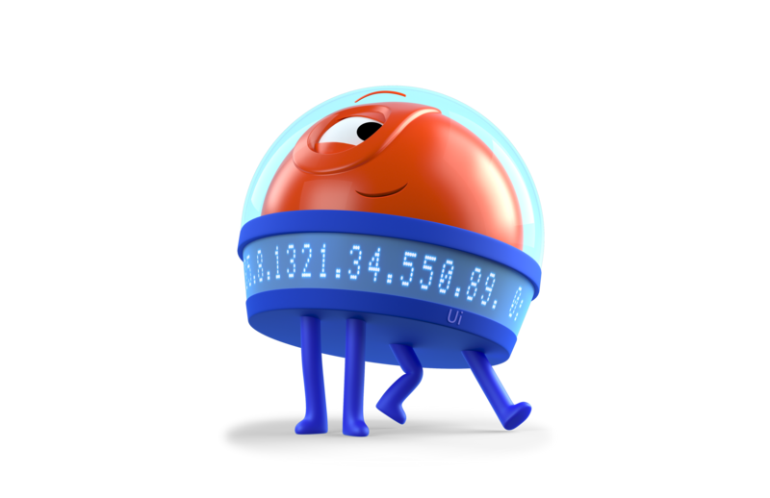

Processing Denied Claims
Robotic Workflow
Denial Received
Robot
Index Patient
Human
Analyze & Categorize
Human
Apply Remedial Action
Robot
Appeal Denial
Robot
Track Status
Robot
Retrieve Response
Completed
Action
Identify patient and service info, denial reason, and attach to case notes / log
Manual
Review medical record, insurance info, etc. to identify denial root cause
Manual
Assign to appropriate team for corrective action, gather required documentation, etc.
Action
Complete necessary forms and transmit to Payer
Action
Access Payer portal and update status in EHR
Action
Extract data from Payer response
Complex, non-uniform text, requires highly-skilled labor
Required action differs based on denial reason and department
Handoff to Human
Validate findings where required
Action
Update EHR, route case to next appropriate step

Slide 36

Processing Denied Claims
Agentic Workflow
Denial Received
Robot
Index Patient
Agent
Analyze & Categorize
Agent
Apply Remedial Action
Robot
Appeal Denial
Robot
Track Status
Robot
Retrieve Response
Completed
Action
Identify patient and service info, denial reason, and attach to EHR
Context
Evaluate denial against medical record, payer policy, to identify root cause
Context
Analyze similarities in previous cases to identify appropriate action
Action
Complete necessary forms and transmit to Payer
Action
Access Payer portal and update status in EHR
Action
Extract data from Payer response
Handoff to Agent
Validate findings where required
Tool
Gather additional documentation from EHR
Action
Update EHR, route case to next appropriate step
Human
Review assessment
Takes minutes, agent asks for help if needed
Human
Help agent with more information if needed
Agent does the time-consuming back-and-forth, people help review

Slide 37
Orchestration Problem
Automation challenge shifts from execution → coordination
Actors:
Humans (governance / fallback / escalations)
Robots (deterministic workflows)
Agents (decision helpers)

Slide 38
Key Takeaways
RPA → efficiency
Agents → decision helpers / adaptability
Orchestration → coordination
Future automation workflows can combine all three

Slide 39
Closing Discussion
Where do your individual and team projects go next?
Individual:
Appropriate identification rules-based automation
Selection of appropriate automation spectrum model
Team:
Appropriate mix of RPA, Agent, and human in the loop
Selection of best cases for agent decision enhancement

Slide 40
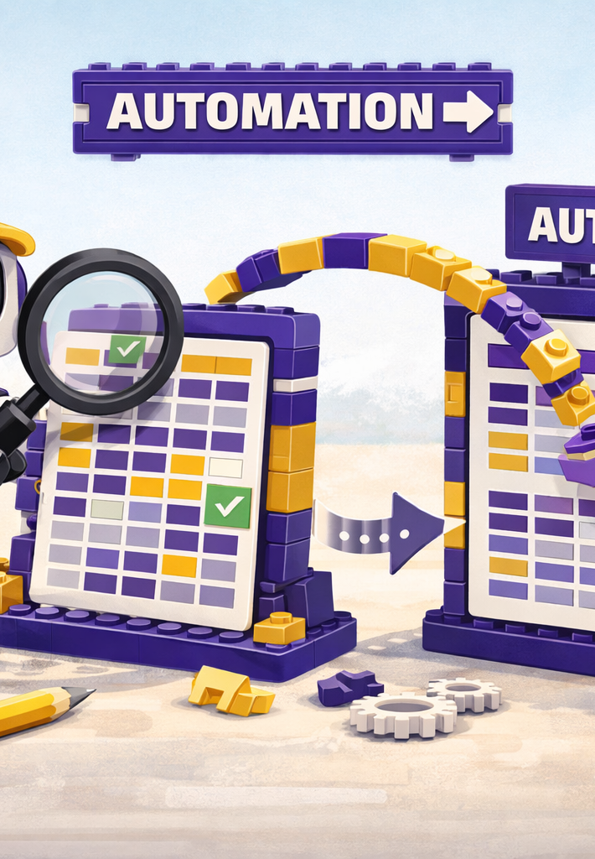
Where we will go next
RPA
Manipulation of files, components
Triggers, Controls, Governance
Costs and benefits of RPA
Agentic
BPMN revision and extension
Tasks for RPA versus Agent
Advanced Prompt Engineering
Scalability

Slide 41
What will we do today?
Review
(Initial) Review of Submissions
Admin: Teams
RPA Models
Automation Model Spectrum
RPA to Agentic workflows discussion
Optional introduction to set-up requirements for an open source approach (time- & interest-permitting).

Slide 42
Open source
Hardware/computing requirements discussion
Reality of open source agents (that run on your laptop)
Free API alternatives
Software requirements discussion
Python upskilling
Orchestration: dealing with complexity / debugging

Slide 43
Thank you

